Slide 1


15+ Years
6,238 Walks
11,229 Miles
32,857 Treats
1 Buddy

Slide 2

delivering innovative, unforgettable treat experiences for all dogs

Slide 3


Background information
Better target and market the world’s healthiest treat developed specifically for dogs
Provide the most optimal treat experience for all different types of dog breeds
Be as good to our dogs as they are to us

Slide 4
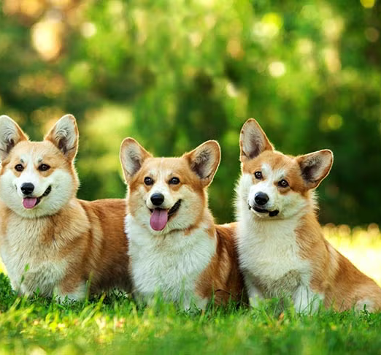
Languages & Environment
Python
MySQL
Google Colab
Jupyter Notebook
MySQLWorkbench
GitHub

Slide 5
Data Sources
External
American Kennel Club (AKC) dataset
breed, temperament, popularity, min_height, max_height, min_weight, max_weight, min_expectancy, max_expectancy, group, energy_level_value, energy_level_category, trainability_value, trainability_category, demeanor_value, demeanor_cateogory
Austin Animal Center Outcomes dataset
name, dob, sex, color, age, type, outcome_type, outcome_subtype, outcome_datetime
Region dataset – worldpopulationreview.com
median_income, pet_ownership
Internal
Doggy Delights customer content
treat_consumption
product_catalog
survey_response

Slide 6
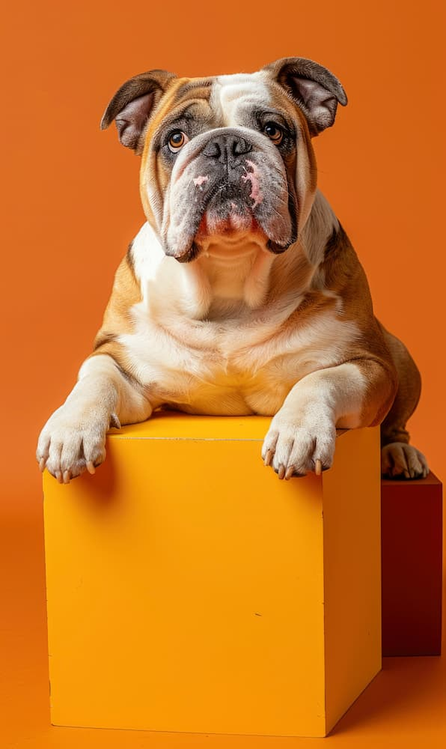
Data quality checks & cleaning
Data cleaning
Before extraction, ETL
Incorrect formats, data types, missing values, outliers, duplicate records
Quality checks
Before data is entered into the database
Form validation on customer survey
Not NULL
Data usage
Access is restricted to authorized employees only to comply with best practice privacy regulations

Slide 7
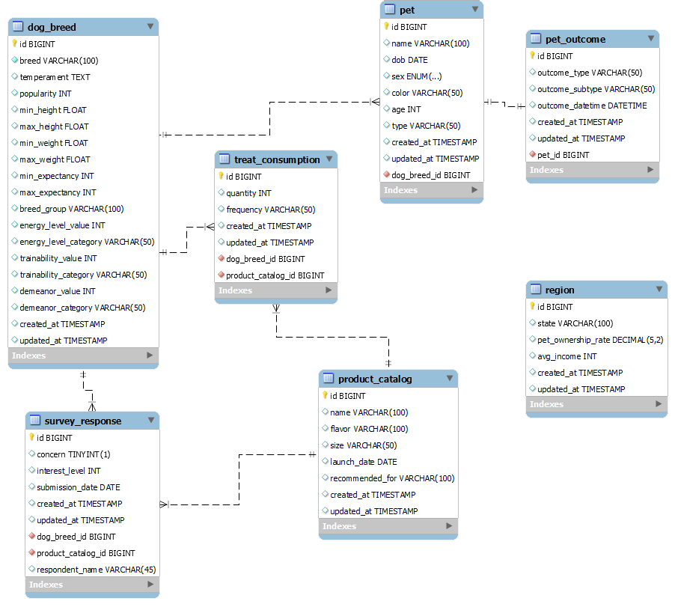
EER Diagram/Database Schema

Slide 8

Tables
Dimension Tables
dog_breed
pet
pet_outcome
product_catalog
region
Fact Tables
treat_consumption
survey_response

Slide 9
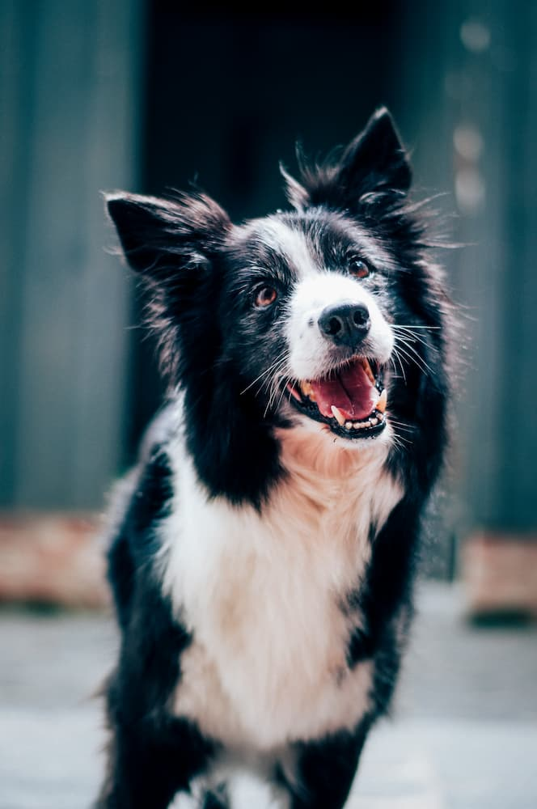




Database Storage
MySQL running on a web server
Not meant for public use and restricted to key employees
Web host provides daily backup and data recovery plan in place to help minimize the potential for a loss of data
MySQL DDB
Google Colab/
Jupyter Notebook
SSH Tunnel
Web Form

Slide 10
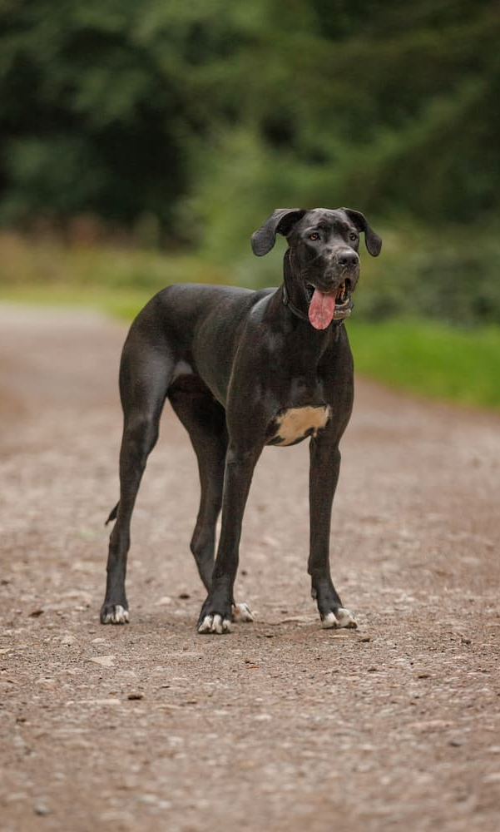
What dog breeds are likely to consume the most treats?
SELECT breed, energy_level_value, popularity,
(energy_level_value * (max_weight + min_weight) / 2 ) AS energy_score
FROM dog_breed
WHERE energy_level_value > 0
AND popularity > 0
ORDER BY energy_score DESC, popularity
LIMIT 10

Slide 11
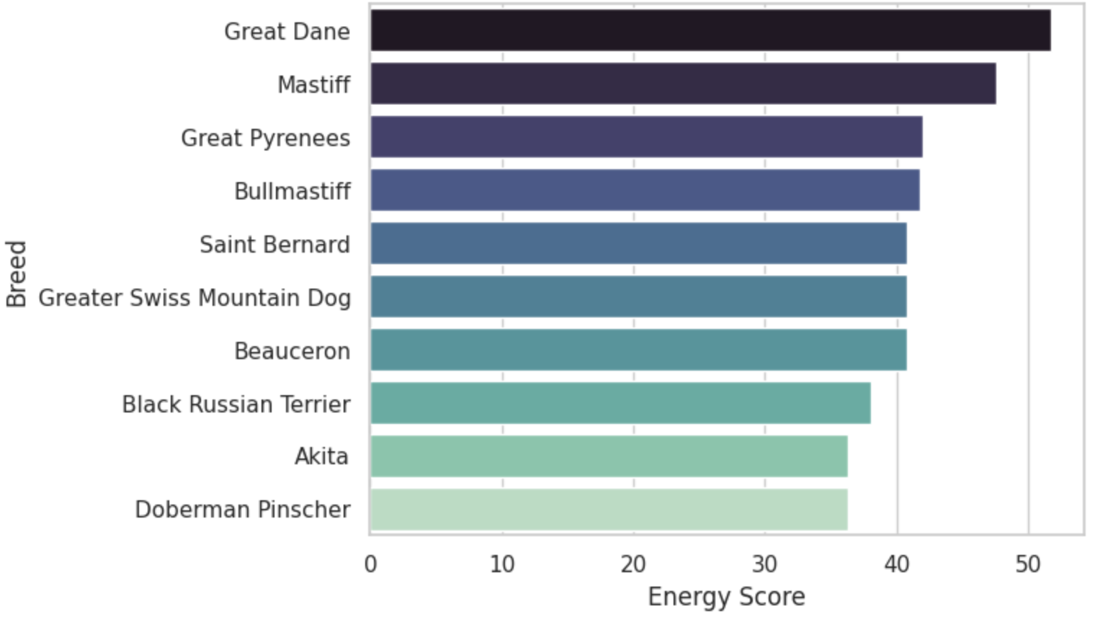
What dog breeds are likely to consume the most treats?

Slide 12

What ARE the most popular dog breeds?
SELECT breed, COUNT(*) AS breed_count
FROM dog_breed
INNER JOIN pet ON dog_breed.id = pet.dog_breed_id
GROUP BY breed
ORDER BY breed_count DESC
LIMIT 10

Slide 13
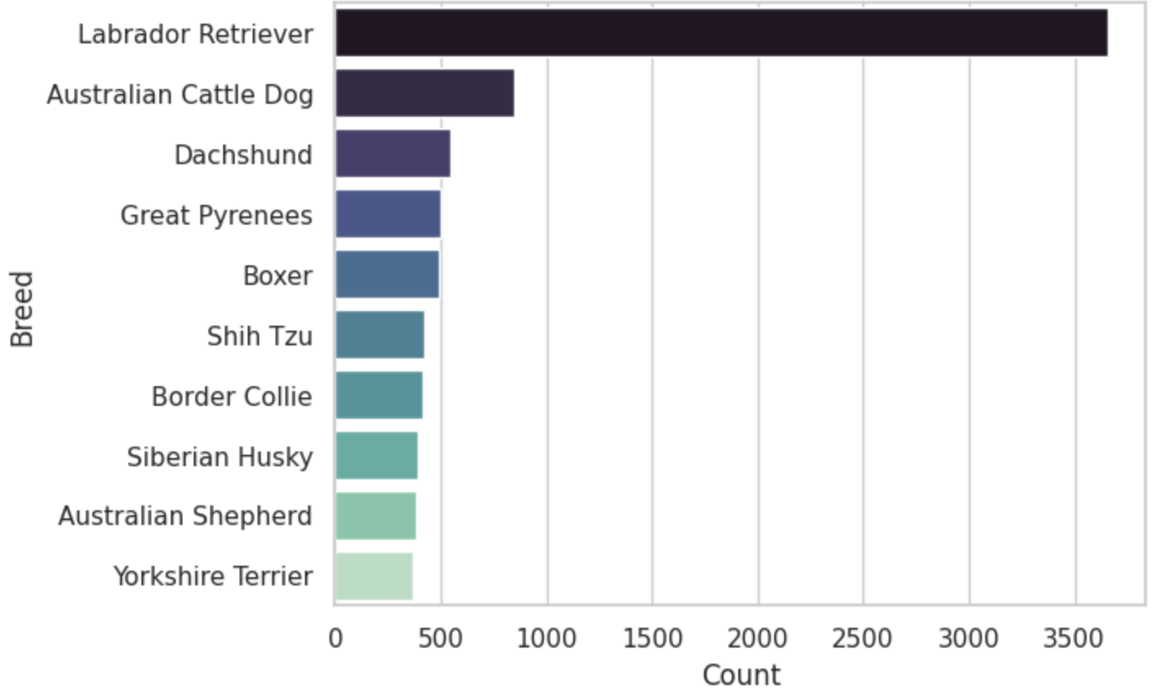
What ARE the most popular dog breeds?

Slide 14
Which breeds have the longest life expectancy and could be consumers for a longer amount of time?

Slide 16


Conclusion
Our data aids Doggy Delights in making critical business decisions
How best to spend marketing budget to efficiently target new and existing customers
A/B testing on website
Streamline enterprise costs
Efficient coding and data storage to save on cloud/hosting costs
As our data grows, it could also potentially help shelter dogs find the perfect home
joedag32
Decabra

